Slide 1
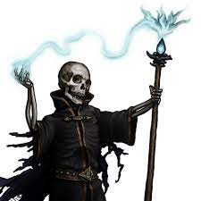
The Night of the Liche
Pitch Date: 12/18/2022 Update 1/1/2023
Release Date: 4/9/2023 45 Commits
Team Lead: Vince McKeown 5 Contributors

Slide 2
Vince McKeown
Alchemist
Added a Voice Introduction
Player
Animated in all directions for walking and standing
Pathfinding – WIP
Added code for music and SFX

Slide 3
Tor Andreas Johnsen
Developer code / cheats
No clip, pass through walls
Invulnerability

Slide 4
Jiho
Alchemist
Alchemist now explores

Slide 5
H Trayford
World Building
Game now supports multiple maps
WIP: Graveyard area

